Slide 1

UTrip
Recitation 014, Group 07
Leo Su
Evan Tseng
Derrick Do
Arjun Peroor
Matt Kind

Slide 2
Description
We strive to provide easy access to travel planning resources for everyone struggling to simply experience the world.
UTrip is a tool that provides the ability to streamline planning of short notice travel.
Finds immediate deals for hotels as well as climate data so you can plan your trip accordingly
Screen Recording the Video

Slide 3









Tools Used
GitHub Repository & Project Board
PostgreSQL
Visual Studio Code
HTML + EJS + Bootstrap
NodeJS Server
Web Browser localhost
RapidAPI
OpenWeather API
Booking.com API

Slide 4
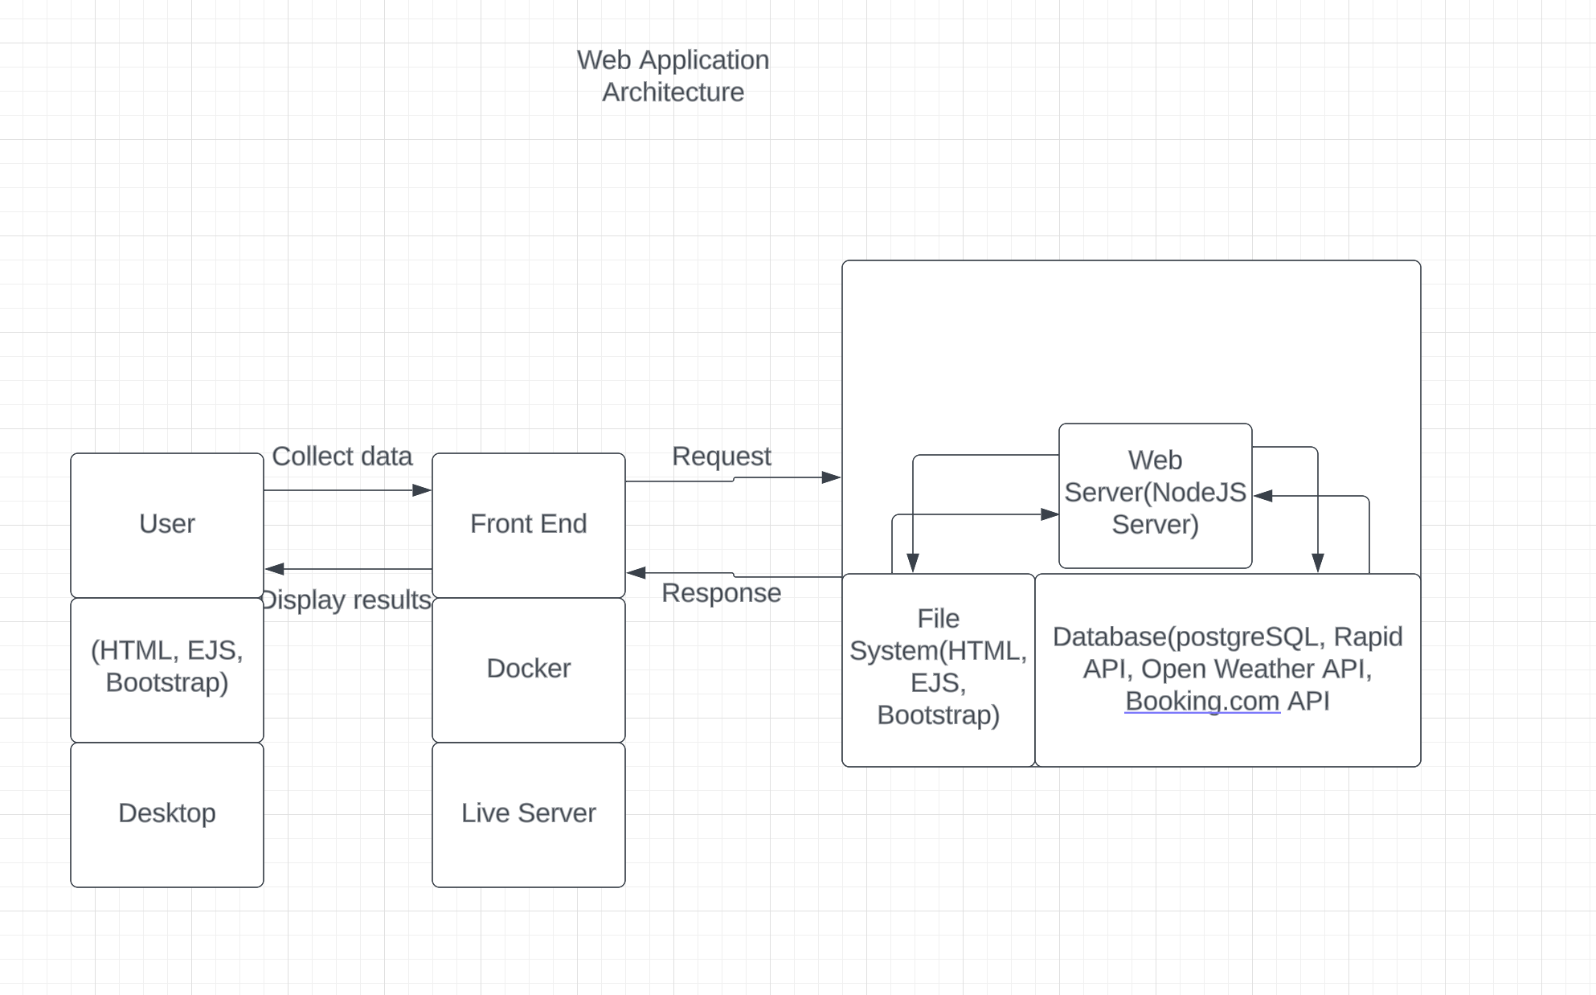
Architecture Diagram

Slide 5
Challenges
Learning how to utilize RapidAPI to pull the hotel data
Getting the location input to interact with both the Weather and Hotel side of the application
Creating the database to store the selected hotels into the user’s trips
Familiarizing ourselves with GitHub to work collaboratively

Slide 6
Live Demo

